Slide 1
Autistic Burnout or Regression Individuals on the Autism Spectrum
South Carolina Speech-Language-Hearing Association
Annual Convention 2019
Jill Barton, M.S.,CCC-SLP

Slide 2
Disclosures
I have relevant financial relationship(s) with South Carolina Speech and Hearing Association
I have received financial compensation for this presentation.
I have no relevant non-financial relationship(s) to disclose.

Slide 3
Why Are We Here Anyway?
This presentation will provide the participant with information regarding various terms used when discussing Autistic Burnout as well as provide a discussion platform for implementation of strategies to increase the recovery period while continuing in a clinical therapy setting.

Slide 4
Learning Objectives
1. Identify & Review terms associated with burnout and regression in autism & communication
2. Compare and discuss various signs and symptoms to help individuals diagnosed on the Autism Spectrum who struggle with Autistic Burnout.
3. Confer vital information regarding the continued ability to provide clinical therapy and collect positive data gains during periods of Autistic Burnout.

Slide 5
What is Burnout?
Definition of NT BURNOUT
1: The cessation of operation usually of a jet or rocket engine
2: Exhaustion of physical or emotional strength or motivation usually as a result of prolonged stress or frustration
2b: A person suffering from burnout
Management of BURNOUT
Stop working
Find a release
Take a break from Alcohol & Caffeine
Ask for less responsibilities
Have a heart-to-heart with someone
Make work more fun
work away from your desk
Use FMLA if necessary
Get plenty of sleep, exercise, and eat well
QUIT YOUR JOB!

Slide 6
What is Autistic Burnout?
Autistic Burnout is an accumulation of years of trying to appear normal and cope as a Neurotypical (NT). The Strain and drain of it suddenly becomes too much and a person with Autism falls apart.
ALL AUTISTIC SYMPTOMS GET WORSE

Slide 7
What is Regression?
Neurotypical:
Regression is a psychological defense mechanism in which a person abandons age-appropriate coping strategies in favor of earlier, more childlike patterns of behavior. This regression is a form of retreat, bringing back a time when the person feels safe and taken care of.
Autism Spectrum:
There is no universally agreed definition; however, all definitions support that regression involves the loss of a previously attained skill, such as language.
Language regression refers, to the loss of verbalizations
Language/social regression, indicates other social behavior involved in addition to the language

Slide 8
Temper Tantrum vs. Autistic Meltdown
Temper Tantrum
Temper tantrums are unpleasant and disruptive behaviors or emotional outbursts.
They often occur in response to unmet needs or desires.
Tantrums are more likely to occur in younger children or others who cannot express their needs or control their emotions when they are frustrated
Autistic Meltdown
Many autistic people will show signs of distress before having a meltdown, which is sometimes referred to as the “rumble stage”.
They may start to exhibit signs of anxiety such as pacing, seek reassurance through repetitive questioning or physical signs such as rocking or becoming very still.
Autistic meltdown is a short term event

Slide 9
The Signs and Symptoms

Slide 11
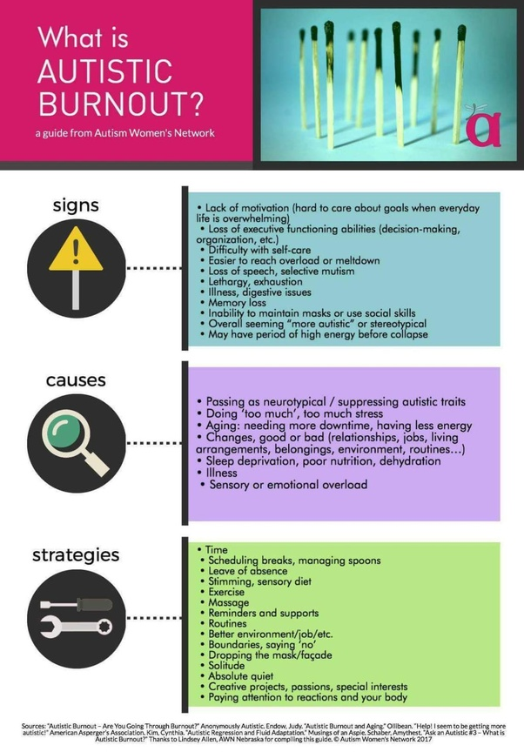

Slide 13
What To Do Now

Slide 17
References
https://www.merriam-webster.com/dictionary/burnout
https://www.quora.com/profile/Myriam-R-Roberts: April 5, 2017
https://www.thebalancecareers.com/how-to-deal-with-work-burnout-4142144
https://psychcentral.com/encyclopedia/regression/
Barger, B.D., Campbell, J.M. & McDonough, J.D. J Autism Dev Disord (2013) 43: 817. https://doi.org/10.1007/s10803-012-1621-x
https://www.ncbi.nlm.nih.gov/pmc/articles/PMC4949854/
Rogers SJ. Developmental regression in autism spectrum disorders. Ment Retard Dev Disabil Res Rev2004; 10: 139–143.
Amythest Schaber; Ask an Autistic #3 - What is Autistic: Burnout?https://youtu.be/DZwfujkNBGk
https://awnnetwork.org/: https://qr.ae/TUrRhw

