Slide 1
AAC is MY JAM!
Christina Stader MCD CCC-SLP
Stephen Kneece MA CCC-SLP

Slide 2
Presenter Contact Information
Christina Stader - Assistive Technology Consultant
Cstader@acpsd.net
Stephen Kneece – Assistive Technology Consultant
skneece@acpsd.net

Slide 3
What is AAC?
Augmentative and Alternative Communication (AAC) includes all forms of communication (other than oral speech)
People with severe speech or language problems rely on AAC to supplement existing speech or replace speech that is not functional
AAC users should not stop using speech if they are able to do so

Slide 4
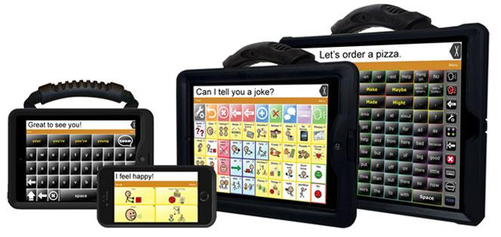
High Tech!

Slide 5
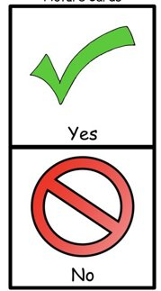
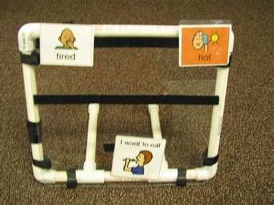
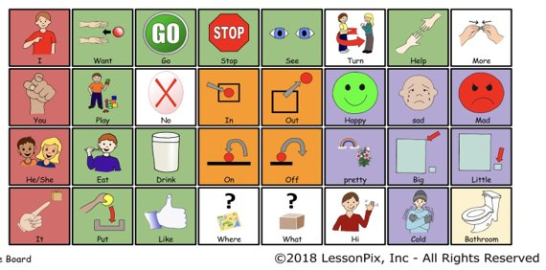
LOW Tech!

Slide 6
AAC Mythbusting!
"AAC will hinder speech development."

Slide 7
AAC Mythbusting!
"AAC systems will make people lazy and stop talking."

Slide 8
AAC Mythbusting!

Slide 9
AAC Mythbusting!
"The individual must be completely non-verbal and have good cognitive skills."

Slide 10
AAC Mythbusting!

Slide 11
AAC Mythbusting!
"AAC is the last resort."

Slide 12
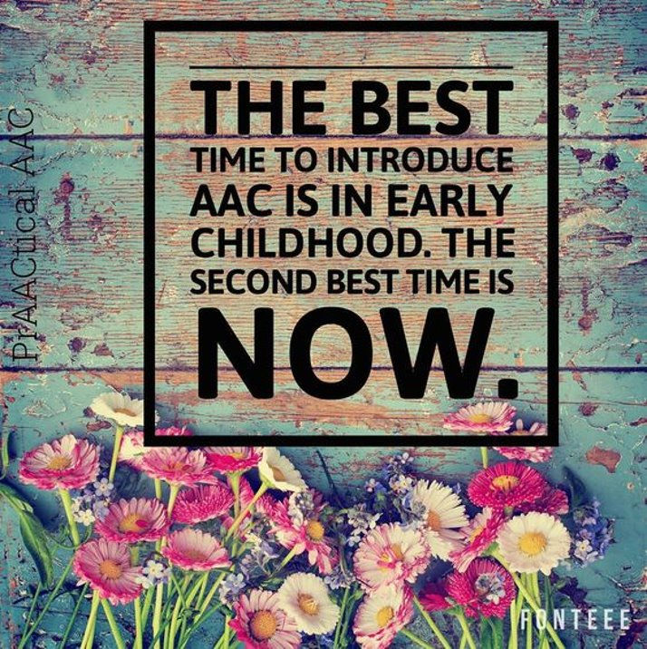
AAC Mythbusting!

Slide 13
AAC Mythbusting!
"Nonverbal children have to start with low tech AAC, before moving on to high tech AAC."

Slide 14
AAC Mythbusting!

Slide 15
What's core got to do with it?
What is core vocabulary?
Core vocabulary is a small set of simple words, in any language, that is used frequently and across contexts (Cross, Baker, Klotz & Badman, 1997).
400-500 words
Makes up 80% of what we say

Slide 16
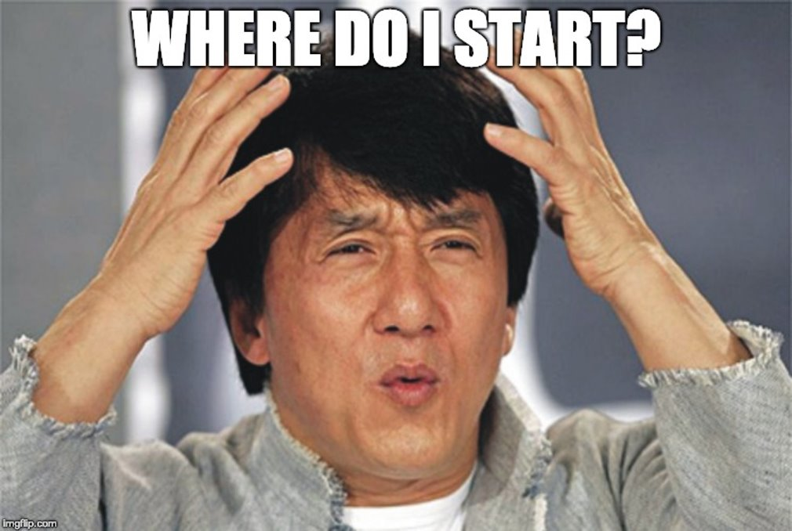

Slide 17
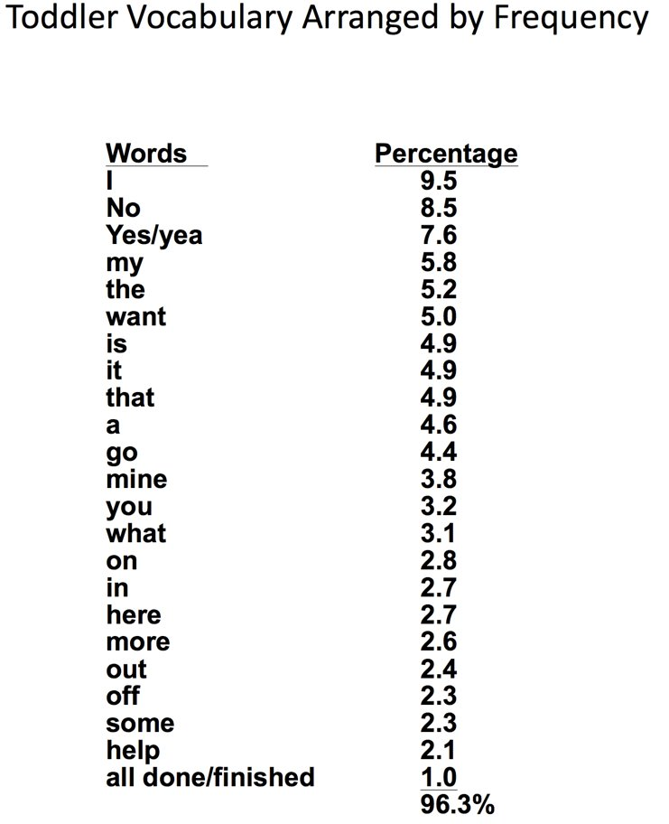

Slide 18
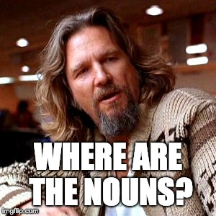

Slide 19
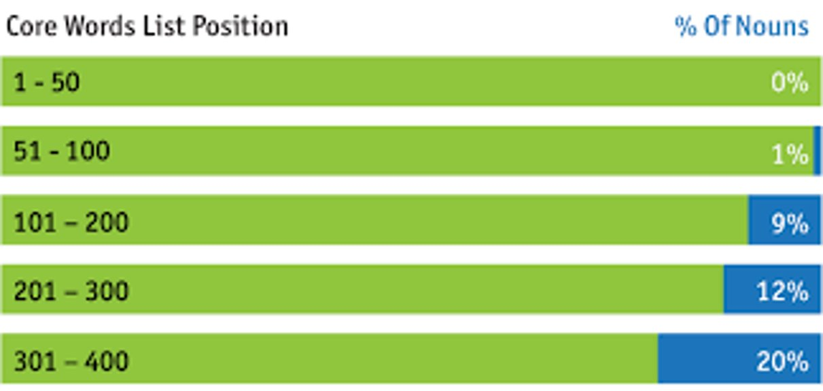

Slide 20
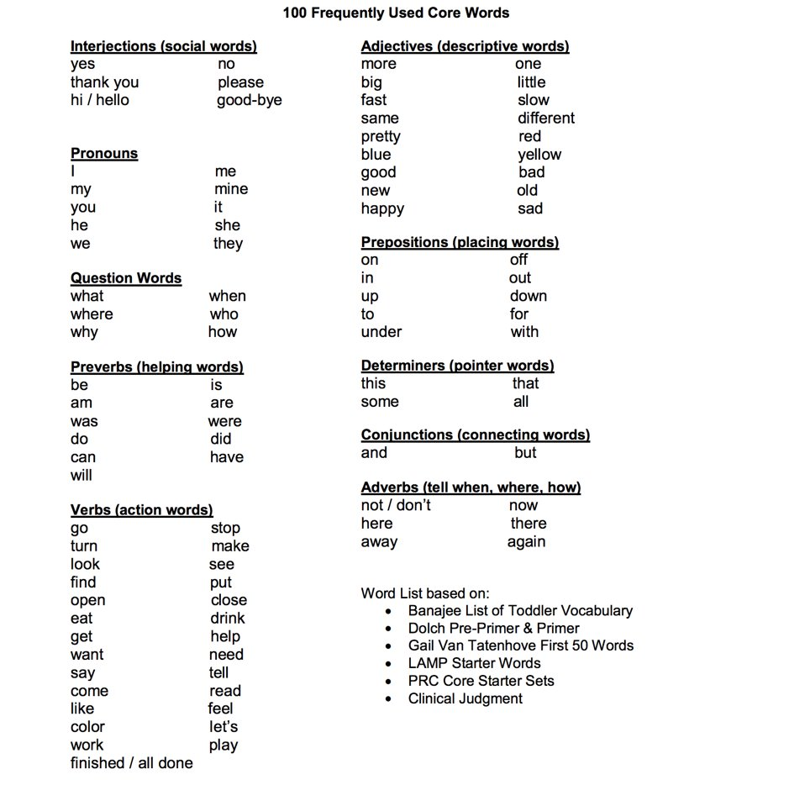

Slide 22
Core OR Fringe
Small number of words​
High frequency​
Applicable to all environments and topics​
Variety of parts of speech​
80% of a speech sample
Large number of words
Low frequency
Applicable to limited environments and topics
Mostly nouns
20% of a speech sample

Slide 23
Core OR Fringe
LIKE

Slide 24
Core OR Fringe
NOT

Slide 25
Core OR Fringe
CAT

Slide 26
Core OR Fringe
THAT

Slide 27
Core OR Fringe
TURN

Slide 28
Core OR Fringe
PIZZA

Slide 29
Core OR Fringe
BATMAN

Slide 30
Core OR Fringe
GO

Slide 31
Core OR Fringe
DIFFERENT

Slide 32
Core OR Fringe
HELP

Slide 33
Where do we go from here?

Slide 34
Where do we go from here?
Start with the end in mind!

Slide 35
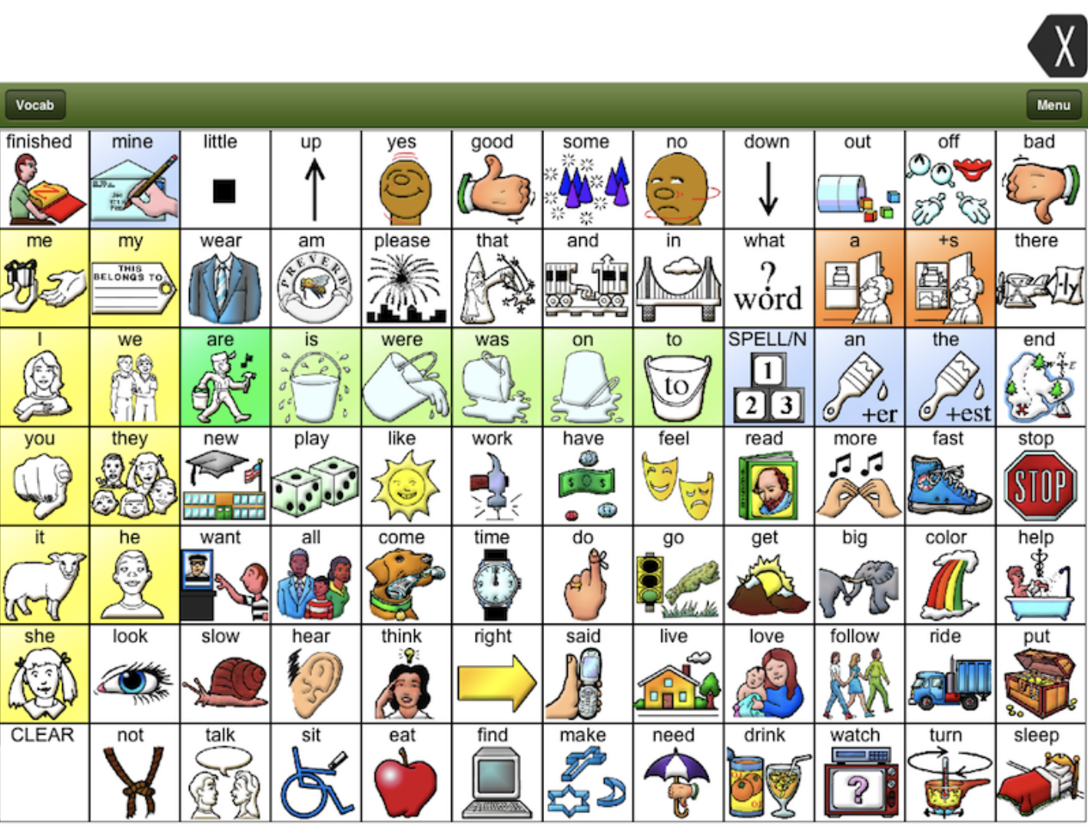
Manual Communication Boards

Slide 36
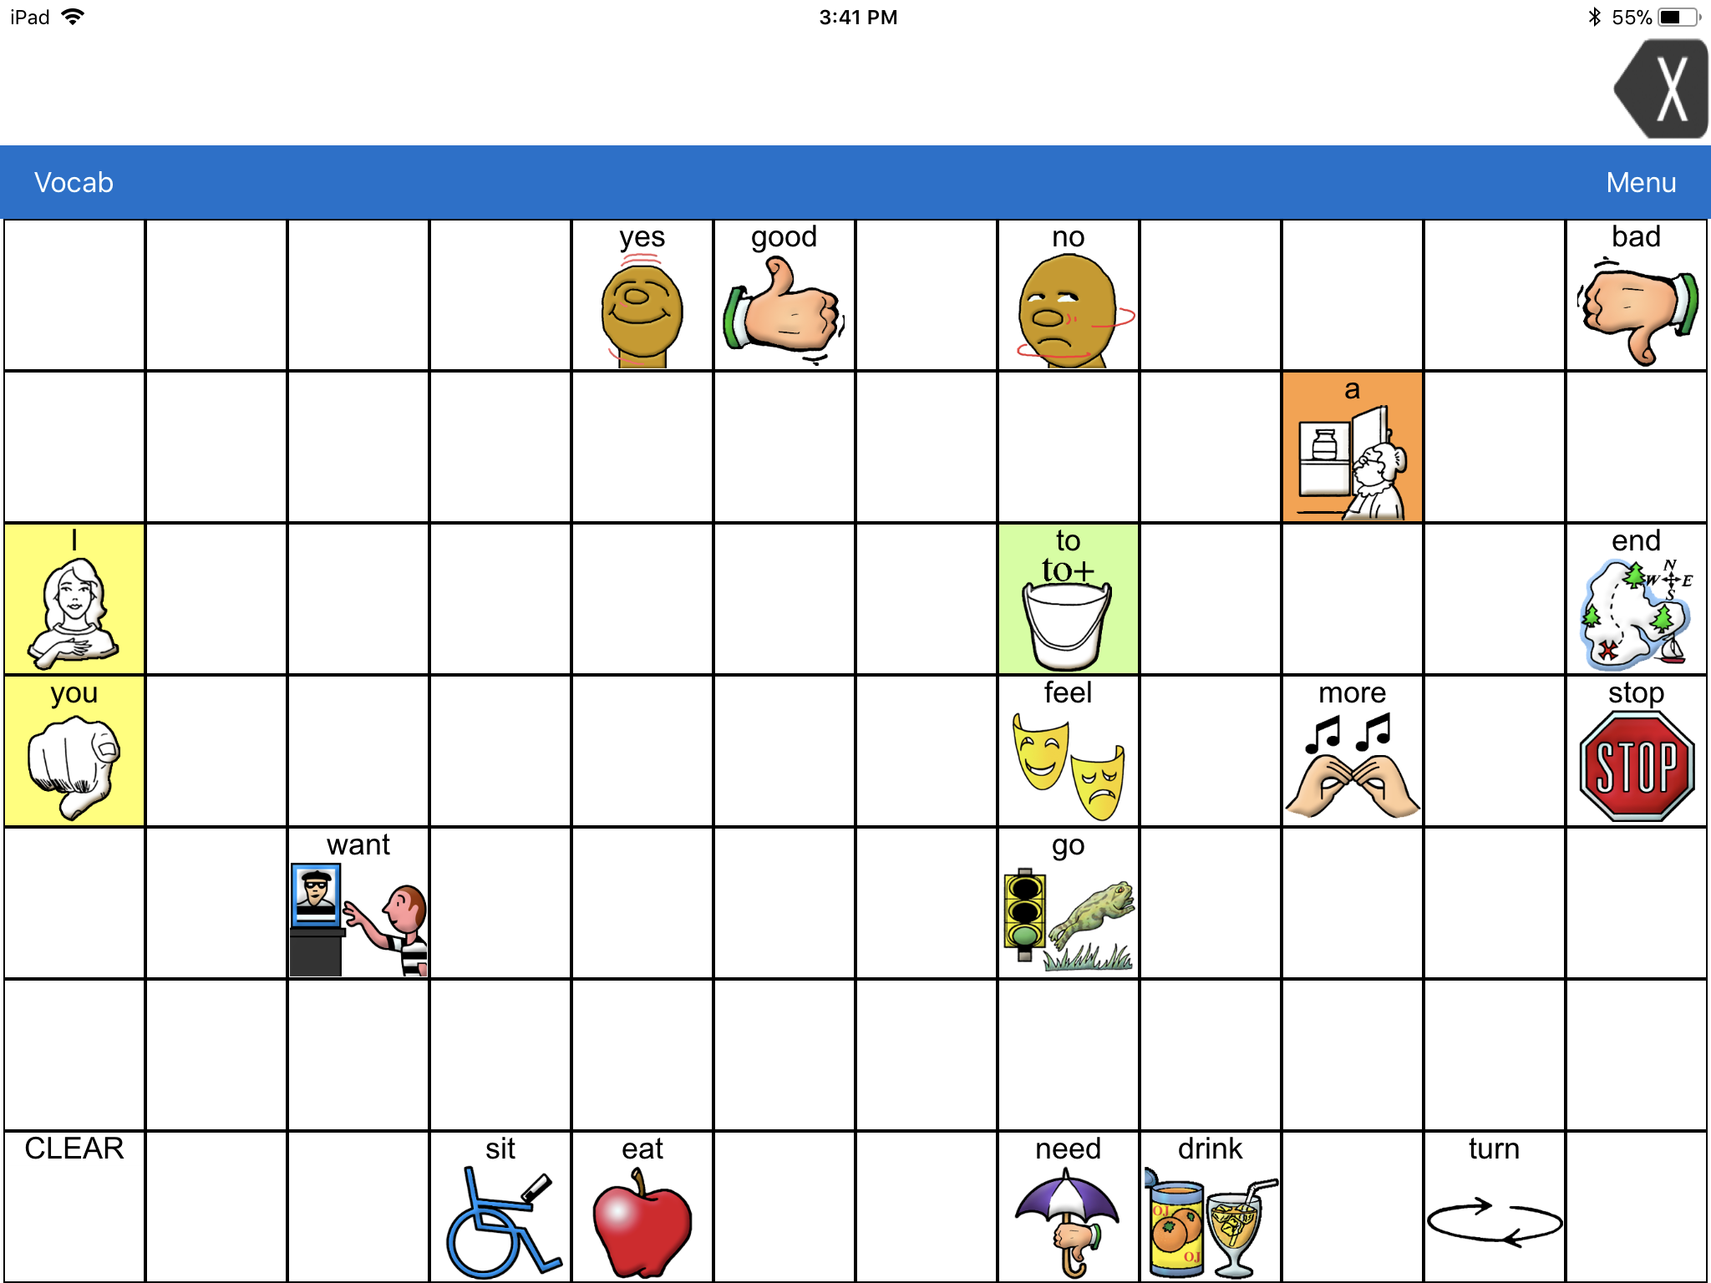
Manual Communication Boards

Slide 37
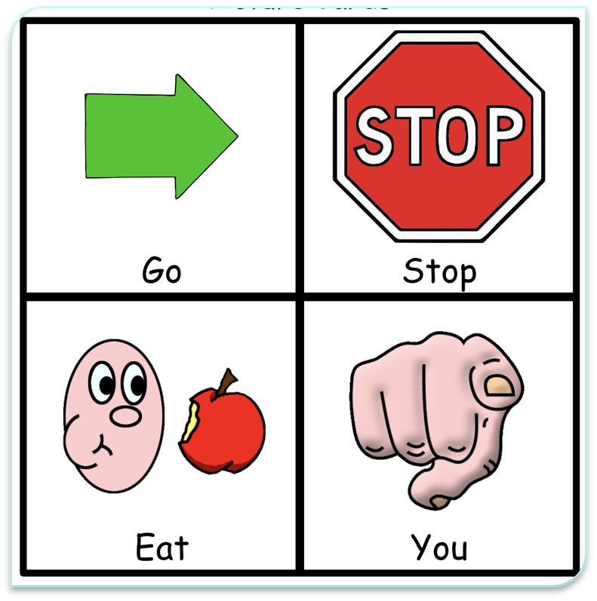

Slide 40
System organization methods
Developed by Louisiana Assistive Technology Initiative

Slide 41
Feature matching chart

Slide 42
Feature matching chart

Slide 43
Why should we trial?
So many options, so many features – Try out different apps and see what features are beneficial for your student
What worked for one student may not work for another student
The app you prefer may not be what your student prefers
Trials give you the data you need to support your decision to go through the process to purchase your student a SGD device. AND, you need data to get funding.
Your student may surprise you!!!

Slide 44
What should it look like?
There are no set "rules" to guide your trials
Our "Best Practice"
Start with an assessment to determine each child's individual needs
Consider the features your child needs and determine the best apps to trial
Complete at least 3 trials of three different programs
Each trial last at least 30 days
Use the results of each trial to guide where you go next

Slide 45
Where do we go from here?
MODEL!

Slide 47
It takes 50-150 models of a word or phrase on the student's device before the student uses that word or phrase on their device. -gail Vantatenhove (2006)

Slide 49
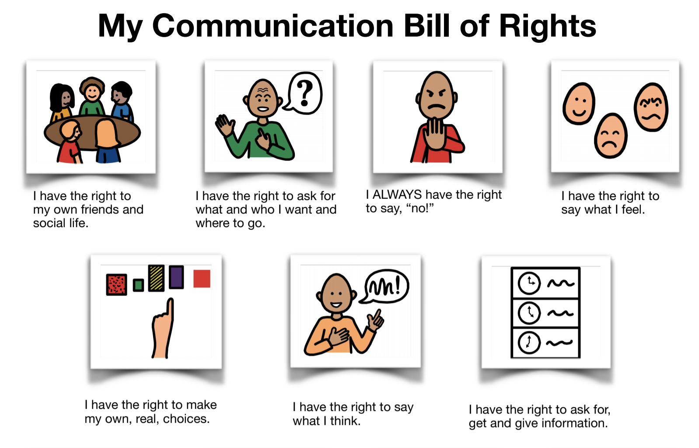
Communication Bill Of Rights

Slide 50
Communication Bill Of Rights

Slide 51
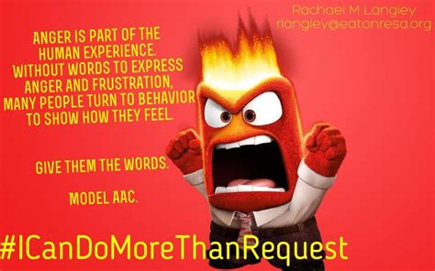

Slide 52
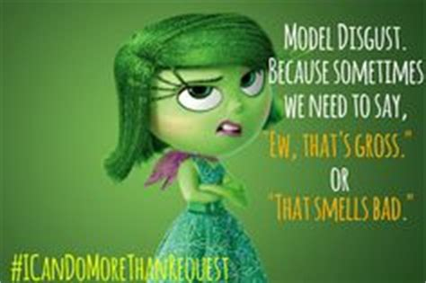

Slide 53
MODEL LEsson

Slide 54
AAC and MUSIC

Slide 55
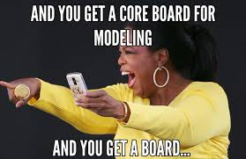
AAC and MUSIC

Slide 56
AAC and MUSIC

Slide 57
Target Core Vocabulary in Books – What would you target?

Slide 58
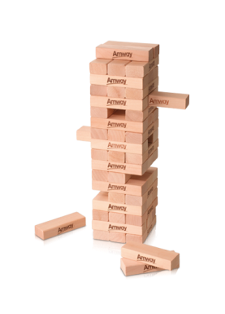
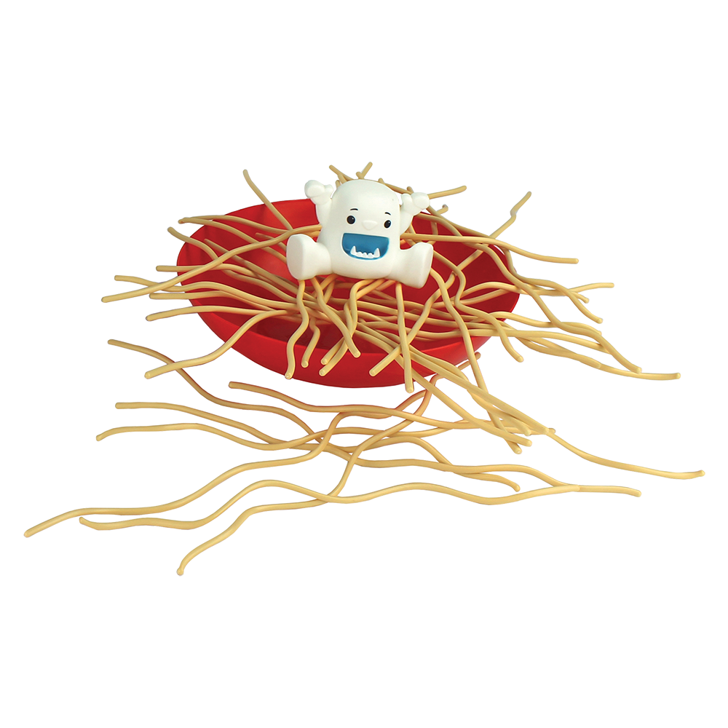
Target Core Vocabulary with games– What would you target?

Slide 59
Presenter Contact Information
Christina Stader - Assistive Technology Consultant
Cstader@acpsd.net
Stephen Kneece – Assistive Technology Consultant
skneece@acpsd.net

